Slide 1
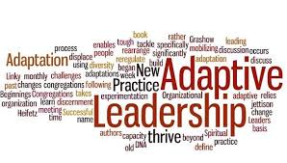
OC 6440
Change Leadership methods and Models
Week 3
Leadership Models

Slide 2
Leadership
Models

Slide 3
A Leader Is Someone Who…
…influences a group of individuals to achieve a common goal. Key aspects of leadership include…
Creating and communicating a vision
Influencing others through use of power
Motivating task behavior in pursuit of shared objectives
Establishing and maintaining group culture
Empowering others
Clarifying roles and niche in marketplace
Making tough decisions with limited information

Slide 4
Leaders and Managers
Leaders Managers
Inspire & Motivate
Manage People
Are Decisive
Create a Vision
Are Accountable
Execute
Manage Resources
Plan, organize, direct, control
Managers who are also leaders

Slide 5
Types of Leadership to Accomplish Change
Collective/Collaborative Leadership
Relies on the collective or collaborative capabilities of the members
Logical for leading change in turbulent times
Cultural proficiency, organizational learning, willingness to experiment
Shared Leadership
Dynamic interactive influence process among individuals/groups
Involves more than downward influence

Slide 6
Types of Leadership (cont’d)
Adaptive Leadership
Works best in complex, chaotic context
Requires adaptive behaviors:
Setting the context
Encouraging organizational member to function as tags (lead without authority, temporary, meaning-making, action taking, etc.)
Establishing ethical standards
Engaging in adaptive work
Developing cultural proficiency
Creating adaptive capability
Address conflicts in values people hold or to diminish the gap between values people stand for and reality
Develop organizational contexts that intentionally attract, learn from, explore, struggle with, and experiment with different ideas, perspectives and culture embedded in diverse environments.
Members are prepared to create fundamentally, behaviors, responsibilities. new structures

Slide 7
Types of Leadership (cont’d)
Tao Leadership
The group members need the leader to provide guidance and facilitation
The leader needs people to lead and people to serve
If each does not recognize the mutual need each misses the point
After the questions (page 61)
Learn to lead in a nourishing manner
Learn to lead without being possessive
Learn to be helpful without taking the credit
Learn to lead without coercion

Slide 8
Types of Leadership (cont’d)
Ubuntu Leadership
Leadership and life as a collective, can only be a person through others
Individuals are most effective when working towards a common good of the group
People develop a set of shared values
Openness, interaction and integrity are key
Groups value consensus
Problems are dealt with as a collective rather than individual

Slide 9
Types of Leadership (cont’d)
Invisible Leadership
Works as collective leadership best in chaotic times, new start-ups or revitalization phases of the life cycle
Individuals lead without regard for recognition or visibility
See page 64
Team and E-Leadership
Based on:
Interaction, interdependence, structure, goals, cohesiveness
Similar to how sports teams will function
Another form of collective leadership

Slide 10
Types of Leadership (cont’d)
Prospects for Collective/collaborative Leadership
Collective forms (adaptive, invisible, team and virtual) of leadership and modified forms of Tao and Ubuntu hold promise for advancing chaos, complexity, dialectical and teleological change
Strategic Leadership
Based on the roles of executive leaders and senior management teams
Strategic leaders adapts and changes the patterns, aims, behaviors of the entire organization
Looks to the future
Reacts to competition, etc.

Slide 11
Types of Leadership (cont’d)
Charismatic Leadership
The attribute has a profound effect on followers
They possess the ability to inspire, build the vision, etc.
Can be either good or bad – authentic or unethical
Servant leadership
Service to followers
Includes nurturing, defending, and empowering

Slide 12
Types of Leadership (cont’d)
Transformational leadership
Leaders motivate followers by:
Making them more aware of the importance of task outcomes
Inducing them to transcend their own self interest for the sake of the organization or team
Activate higher order needs
The Four I’s
Idealized Influence (II) – the role model
Inspirational Motivation (IM) – compelling future
Intellectual Stimulation (IS) – stimulate innovation/creativity
Idealized Consideration (IC) – special attention. Support, etc.

Slide 13
Types of Leadership (cont’d)
Transactional Leadership
Motivation based on the exchange – you perform a task to receive a reward
Contingency Rewards (CR)
Positive exchanges
Management By Exception (MBE)
Corrective Transaction
Laissez-faire (LF)
Passive, lack of involvement
The most ineffective form of leadership

Slide 14
Transactional Vs. Transformational Leadership
Transactional Leadership focuses on clarifying employees’ roles and providing rewards contingent on performance
Appeals to what followers want (rewards)
Transformational transforms employees to pursue organizational goals over self-interest
Appeals to followers’ values, beliefs, self-concept

Slide 15
Types of Leadership (cont’d)
Contingency theories
Path-Goal Theory
Task-Relations-and-Change

Slide 16
Contingency Approaches: Does Leadership Vary With The Situation?
Paul Hersey and Kenneth Blanchard proposed the situational leadership theory which suggests that leaders should adjust their leadership style according to the readiness (extent to which employees are willing and able to complete a task) of followers
-relationship behavior is the extent to which leaders maintain personal relationships with their followers
-task behavior is the extent to which leaders organize and explain the role of their followers
The Hersey-Blanchard model is widely used as a training tool, but because it has not been strongly supported by scientific research, managers should be cautious when using prescriptions from the model

Slide 17
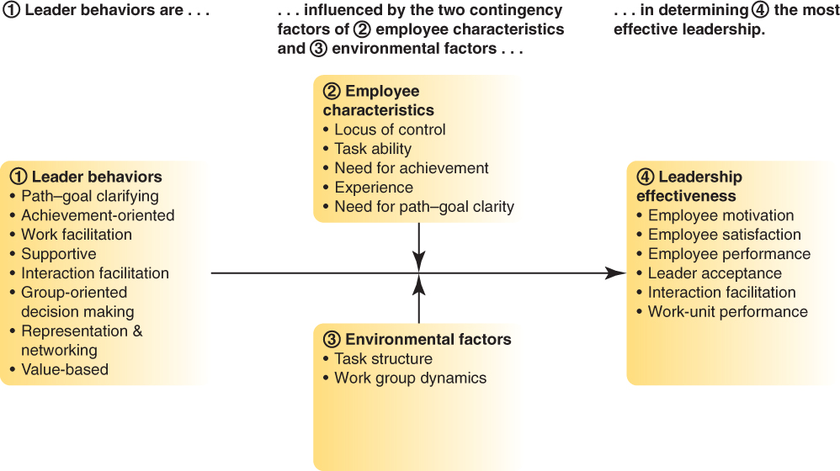
Contingency Approaches: Does Leadership Vary With The Situation?
General Representation Of House’s Revised Path-Goal Theory

Slide 18
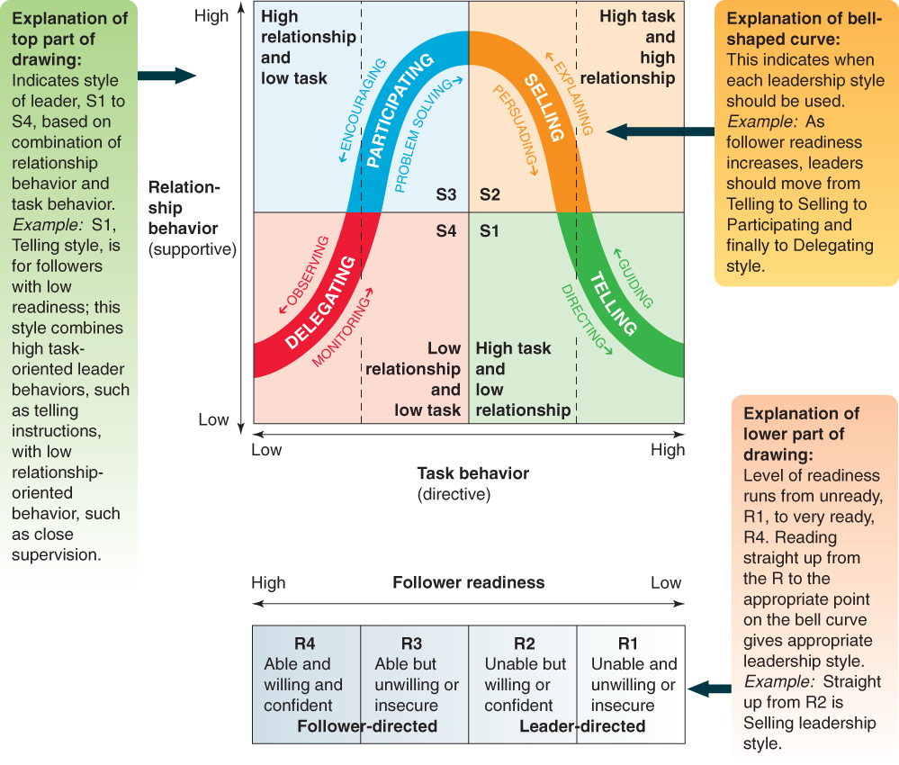
Contingency Approaches: Does Leadership Vary With The Situation?
Hersey and Blanchard’s Situational Leadership Model

Slide 19
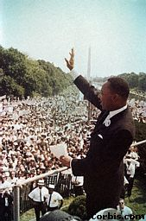
Trait Approach to Leadership
“Great Man” approach
Attempt to identify relatively stable, enduring dispositional attributes that leaders possess
Implicit Leadership Theory
Beliefs about how leaders should behave and should do for their followers
Emotional Intelligence
Ability to manage oneself and one’s relationships in mature and constructive ways.

Slide 20
Kouzes’ and Posner’s - Five Essential Practices of Leadership
Model the way
Find your voice
Set the example
Inspire a shared vision
Envision the future
Enlist others
Challenge the process
Search for opportunities
Experiment and take risks
Enable others to act
Foster collaboration
Strengthen others
Encourage the heart
Recognize contributions
Celebrate the values and victories

Slide 21
Change Leadership

Slide 22
Eight Steps to Transforming Your Organization
1 Establish a Sense of Urgency
2 Forming a Powerful Guiding Coalition
3 Creating a Vision
4 Communicating the Vision
5 Empowering Others to Act on the Vision
6 Planning for and Creating Short-Term Wins
7 Consolidating Improvements and Producing Still More Change
8 Institutionalizing New Approaches

Slide 23
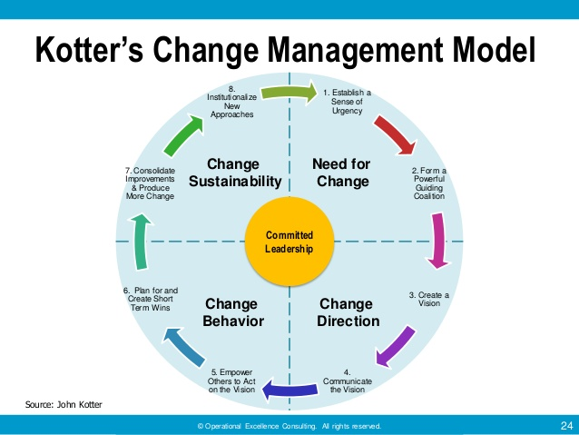

Slide 24
A Nine-step Process For Leading Organizational Change
Create a Sense of Urgency
Decide What to Change
Create a Guiding Coalition and Mobilize Commitment
Develop and Communicate a Shared Vision
Empower Employees to Make the Change
Generate Short-Term Wins
Consolidate Gains and Produce More Change
Anchor the New Ways of Doing Things in the Company Culture
Monitor Progress and Adjust the Vision as Required

Slide 25
Lewin’s Change Model
Unfreezing
Movement
Refreezing

Slide 26
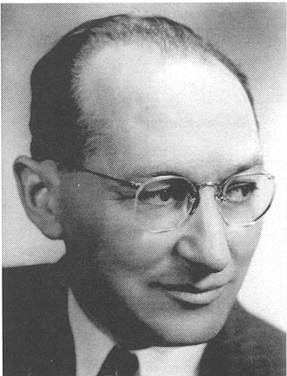
Process of Planned Change
Kurt Lewin
Unfreezing
Moving
Refreezing
Provide rationale for change
Create minor levels of guilt/anxiety about not changing
Create sense of psychological safety concerning change
Provide information that suspects proposed changes
Bring about actual shifts in behavior
Implement new evaluation systems
Create minor levels of guilt/anxiety about not changing
Implement new hiring and promotion systems
Adapted from Exhibit 14-3: Process of Planned Change
Notes:
“Unfreezing” starts on mouse click followed by text after one second. Arrow starts on mouse click followed by “moving” and then text after one second each. Arrow starts on mouse click followed by “refreezing” and text after one second each.
Unfreezing – A phase in the change process in which leaders help managers and associates move beyond the past by providing a rationale for change, by creating guilt and/or anxiety, and by creating a sense of psychological safety concerning the change.
Tactics for unfreezing include:
Reminding individuals that they have successfully changed in the past
Communicating to individuals that managers and associates in other organizations in similar circumstances have successfully changed
Letting individuals know that support and training will be available for the specific changes to be made
Moving – A phase in the change process in which leaders help to implement new approaches by providing information that supports proposed changes and by providing resources and training to bring about actual shifts in behavior.
Refreezing - A phase in the change process in which leaders lock in new approaches by implementing evaluation systems that track expected behaviors, by creating reward systems that reinforce expected behaviors, and by ensuring that hiring and promotion systems support the new demands.

Slide 27

PAU!

